Slide 1
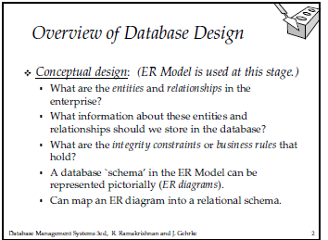

Slide 2
The ER data model allows to describe the data involved in a real-world enterprise in terms
Of objects and their relationships and is widely used to develop an initial database design.
The database design process is divided into six steps. The ER model is most relevant to the
First three steps
1 Requirements Analysis :- What data is stored, what application must be build on the data.
These are obtained from the existing operating environment (changes in it, updations in it,
interaction with user groups. Several methods and automated tools have been developed
To support them.
2. Conceptual Database Design:- The data gathered from the first step is used in preparing a
High level description of the data, which is to be stored in the database, along with the
Constraints . This is done using the ER model which is the high-level or semantic data model
Used in the database design.
3. Logical database design:- A DBMS is choosen for implemented. The conceptual database
is converted into database schema ( We consider only relational database schema)

Slide 3
4. Schema Refinement:- In the process of refining the database, normalization techniques
are employed.
Physical database Design:- Taking into consideration of performance creiteria ,
refinements to the database is done.
Application and Security Design:- The user roles who can access which part of the data
Are identified and grants to that part of the data is done.

Slide 4
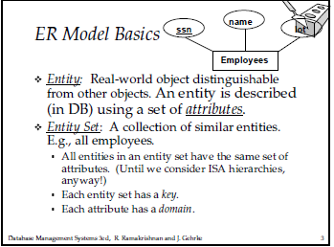
We may have more than one key, one is called the primary key, the
rest are candidate key

Slide 5
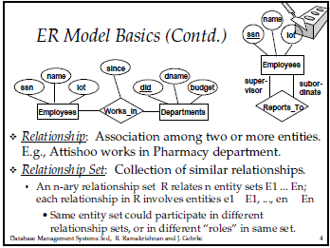

Slide 6
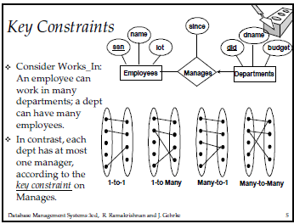
Since is the descriptive attribute which is used to records information about the relationship
Rather than about any one of the participating entities. Each manages relationship must be
Uniquely identified by the combination of employee ssn and department did, so cannot have
More than one associated since value for a given employee_department pair.

Slide 7
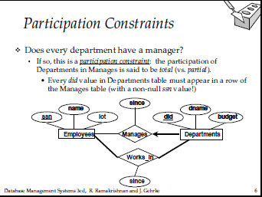
Constraints to the relations.
Unary relation (identify with the roles in the relation
binary,
ternary relation
The arrow from Dept to employee says, each dept has at most one manager, but single employee is allowed to manage more than one department.(one to many)
The works_in relationship is of the type many-to-many. If we add the restriction that each employee can manage at most one department, then it is one-to-one.
Total Participation has bold lines, partial has normal lines

Slide 8
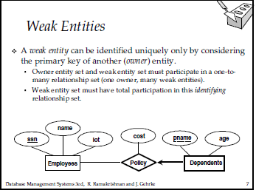
The weak entity can be identified uniquely only by considering some of its attributes in
Conjuction with the primary key of another entity, called indentifying owner.
The owner entity set and the weak entity set must participate in a oen-to-many relation
Called the identifying relationship.
The set of attributes of a weak entity set that uniquely identify a weak entity for a given
Owner entity is called a partial key of the weak entity set.

Slide 9
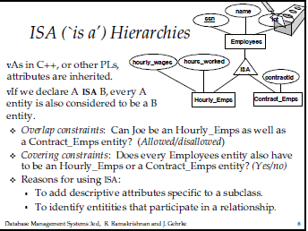

Slide 10
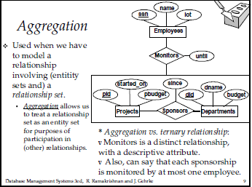

Slide 11
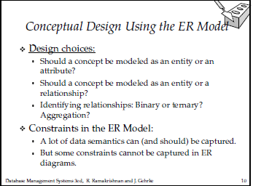

Slide 12
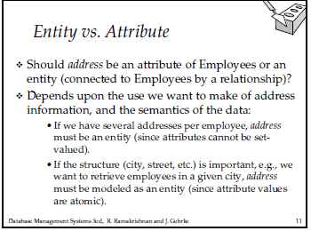

Slide 13
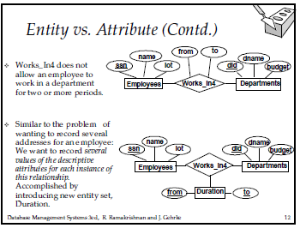

Slide 14
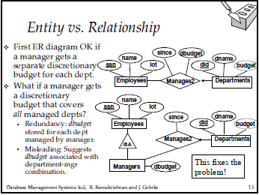

Slide 15
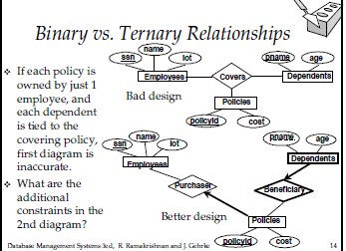

Slide 16
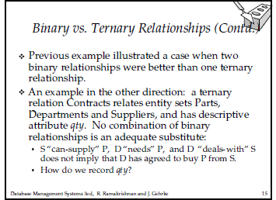

Slide 17
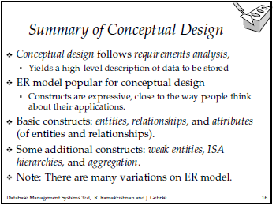

Slide 18
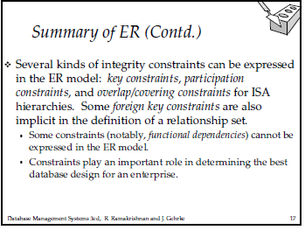

Slide 19
